Slide 1
HTTP/2.0 Servlet 4.0
Andrii Bezruchko
Junior Software Engineer @ EPAM

Slide 2
AGENDA
History of HTTP
Drawbacks of HTTP 1.1
HTTP 2.0 features
Survey of Servlet 4.0
How to use the HTTP 2.0 features with Servlet 4.0

Slide 3
HOW WE GOT HERE
1991
HTTP 0.9
1999
HTTP 1.1
2015
HTTP 2.0
1996
HTTP 1.0
2009
SPDY 1.0

Slide 4
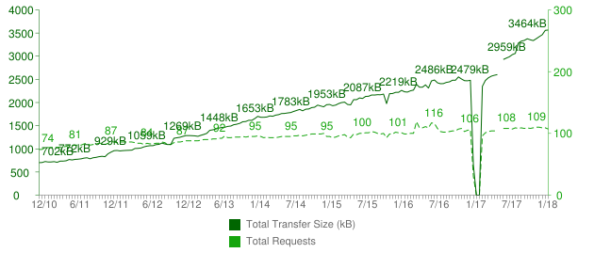
Total Transfer Size & Total Requests

Slide 5

HTTP HISTORY
HTTP/2.0 based on SPDY ( developed by GOOGLE )
TESTS OF SPDY SHOWED :
in some cases, pages were loaded 55% faster
the average load time was reduced by 36%
SPDY
protocol

Slide 6
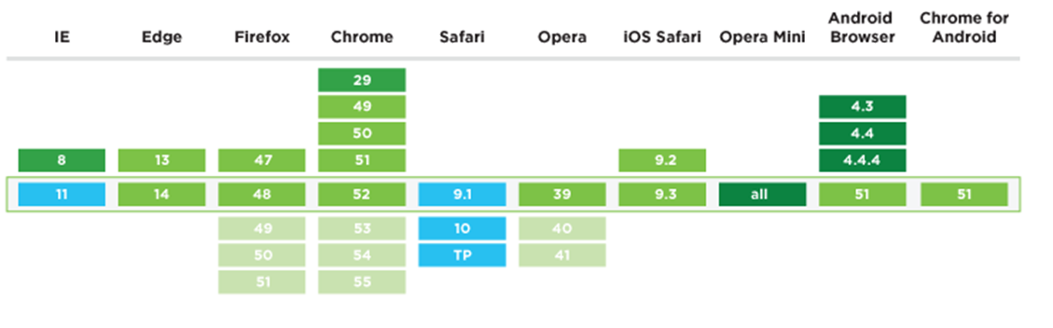
Browser Compatibility of HTTP/2

Slide 7
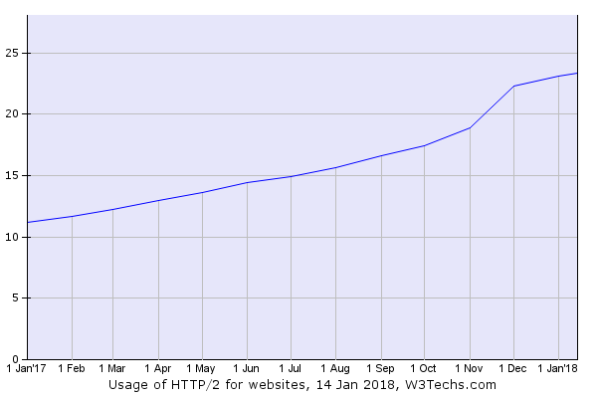
SUPPORT OF HTTP/2
22.3% of all Web sites support the HTTP/2 protocol

Slide 8

SUPPORT OF HTTP/2
IIS: Windows Server 2016
Apache 2.4.17
nginx 1.9.5
Apache Tomcat 9.0.0
WildFly 10
Jetty Stable-9
Netty 4.1
Payara 5.0
Vert.x
GlassFish 5.0

Slide 9

Problem of HTTP/1.1
Responds in sequence
Head-of-Line blocking
One request per TCP connection
HTTP header fields are often repetitive and verbose

Slide 10
client
server
client
server
open
open
close
close

Slide 11


Slide 12
client
server
client
server
open
open
HOL
close
close

Slide 13
How developers resolves problems of HTTP 1.1
Creating sprites
Inlining
Joining
Sharing

Slide 14
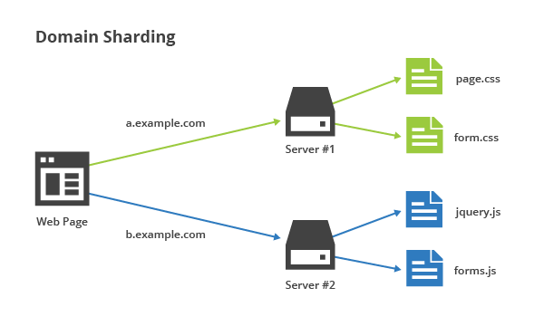

Slide 15

Image sprites

Slide 16
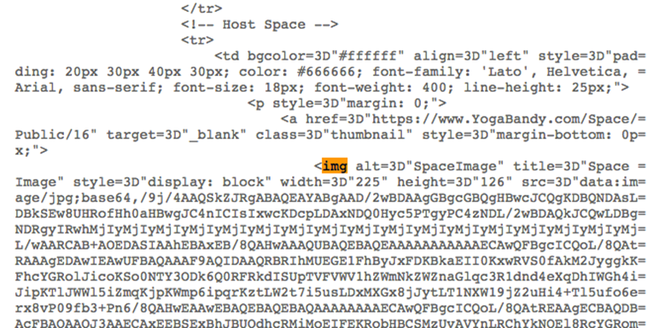

Slide 17
How HTTP/2.0 resolves problems
Request/Response multiplexing
Stream Prioritization and Dependency
Server Push
Header compression

Slide 18
HTTP/2 Units
CONNECTION
FRAME
FRAME
FRAME
FRAME
STREAM
• Connection – single TCP connection
• Streams - channel that carries messages in two directions
• Messages - request or response
• Frames – messages, which are broken down for sending

Slide 19
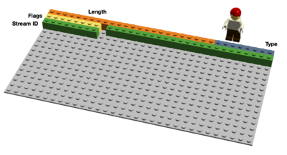
Binary Framing
LENGTH (24)
TYPE (8)
FLAGS (8)
R
STREAM IDENTIFIER (31)
FRAME PAYLOADS (0..N)

Slide 20
Type of Frames in HTTP/2.0
DATA
Used to transport HTTP message bodies
HEADERS
Used to communicate header fields for a stream
PRIORITY
Used to communicate sender-advised priority of a stream
RST_STREAM
Used to signal termination of a stream
SETTINGS
Used to communicate configuration parameters for the connection

Slide 21
Type of Frames in HTTP/2.0
PUSH_PROMISE
Used to signal a promise to serve the referenced resource
PING
Used to measure the roundtrip time and perform "liveness" checks
GOAWAY
Used to inform the peer to stop creating streams for current connection
WINDOW_UPDATE
Used to implement flow stream and connection flow control
CONTINUATION
Used to continue a sequence of header block fragments

Slide 22
HTTP/2.0 HEADLINE FEATURE
Multiplexing
Priority
Flow control
Header compression
Server push

Slide 23
HTTP/2.0 HEADLINE FEATURE
Multiplexing
Priority
Flow control
Header compression
Server push

Slide 24
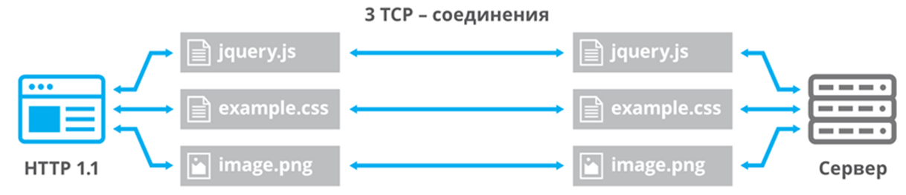
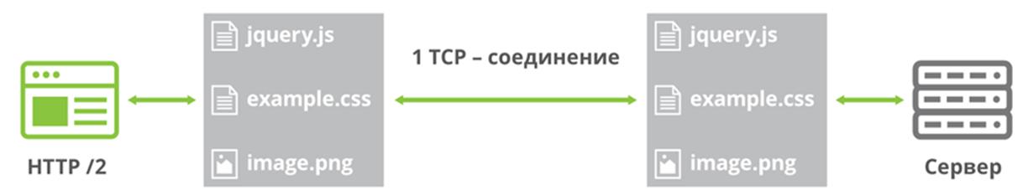
Request/Response Multiplexing

Slide 25
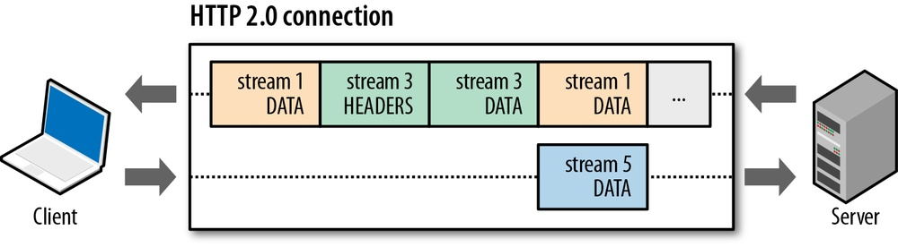
Request/Response Multiplexing

Slide 26
Maximum concurrent open TCP connections
Browser | Parallel connections per hostname
Chrome | 6
Firefox | 6
Opera | 6
Safari | 6
Internet Explorer 11 | 13
Microsoft Edge | 13

Slide 27
HTTP 1.1 round-trip
GET /install.html HTTP/1.1
GET /install HTTP/1.1
Host: maven.apache.org
SecurityToken: j13c72208c9u5fa2
Accept: application/json
Accept-Encoding: gzip
Content-Length: 327
Cache-Control: private, max-age=60, s-maxage=0
Vary: SecurityToken
Date: Wed, 17 Jan 2018 21:31:57 GMT
Content-Type: application/json
Content-Encoding: gzip
GZIPPED DATA

Slide 28
HTTP/2 round-trip
HEADERS
Stream: 3
Flags: END_HEADERS, END_STREAM
HEADERS
Stream: 3
Flags: END_HEADERS
:method: GET
:authority: maven.apache.org
:path: /install.html
securitytoken: j13c72208c9u5fa2
accept: application/json
accept-Encoding: gzip
:status: 200
content-Length: 327
cache-Control: private, max-age=60, s-maxage=0
vary: SecurityToken
date: Wed, 17 Jan 2018 21:31:57 GMT
content-Type: application/json
content-Encoding: gzip
DATA
Stream: 3
Flags: END_STREAM
GZIPPED DATA

Slide 29
Comparison requests of HTTP 1.1 & HTTP/2
Host: maven.apache.org
SecurityToken: j13c72208c9u5fa2
Accept: application/json
Accept-Encoding: gzip
HEADERS
Stream: 3
Flags: END_HEADERS, END_STREAM
GET /install.html HTTP/1.1
:method: GET
:authority: maven.apache.org
:path: /install.html
securitytoken: j13c72208c9u5fa2
accept: application/json
accept-Encoding: gzip

Slide 30
Comparison responses of HTTP 1.1 & HTTP/2
GET /install HTTP/1.1
HEADERS
Stream: 3
Flags: END_HEADERS
Content-Length: 327
Cache-Control: private, max-age=60, s-maxage=0
Vary: SecurityToken
Date: Wed, 17 Jan 2018 21:31:57 GMT
Content-Type: application/json
Content-Encoding: gzip
:status: 200
content-Length: 327
cache-Control: private, max-age=60, s-maxage=0
vary: SecurityToken
date: Wed, 17 Jan 2018 21:31:57 GMT
content-Type: application/json
content-Encoding: gzip
GZIPPED DATA
DATA
Stream: 3
Flags: END_STREAM
GZIPPED DATA

Slide 31
HTTP/2 interleaving
HEADERS
Stream: 3
Flags: END_HEADERS, END_STREAM
HEADERS
Stream: 5
Flags: END_HEADERS, END_STREAM
HEADERS
Stream: 3
Flags: END_HEADERS
HEADERS
Stream: 5
Flags: END_HEADERS
DATA
Stream: 5
Flags:
DATA
Stream: 3
Flags: END_STREAM
DATA
Stream: 5
Flags: END_STREAM

Slide 32
HTTP/2 canceling a Stream
HEADERS
Stream: 3
Flags: END_HEADERS, END_STREAM
HEADERS
Stream: 5
Flags: END_HEADERS, END_STREAM
HEADERS
Stream: 3
Flags: END_HEADERS
HEADERS
Stream: 5
Flags: END_HEADERS
RST_STREAM
Stream: 5
ErrorCode: CANCEL
DATA
Stream: 5
Flags:
DATA
Stream: 3
Flags: END_STREAM

Slide 33
HTTP/2 control frames
HEADERS
Stream: 3
Flags: END_HEADERS, END_STREAM
HEADERS
Stream: 5
Flags: END_HEADERS, END_STREAM
HEADERS
Stream: 3
Flags: END_HEADERS
HEADERS
Stream: 5
Flags: END_HEADERS
SETTINGS
Stream: 0
Flags:
DATA
Stream: 5
Flags:
SETTINGS
Stream: 0
Flags: ACK
DATA
Stream: 3
Flags: END_STREAM
DATA
Stream: 5
Flags: END_STREAM

Slide 34
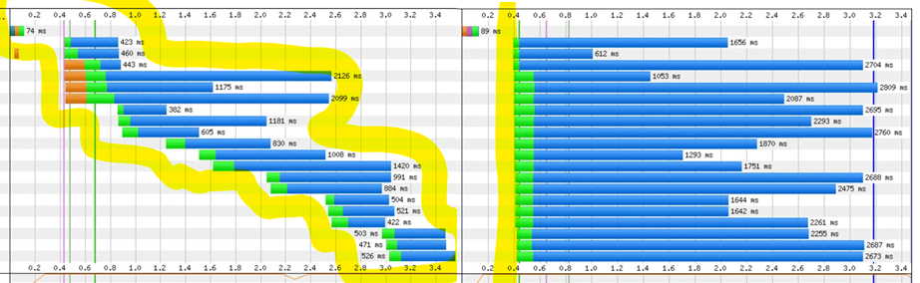

Slide 35
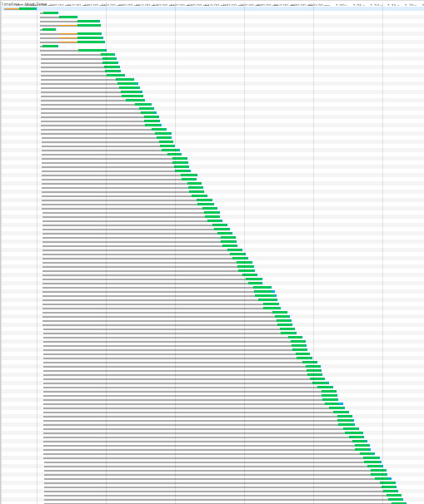
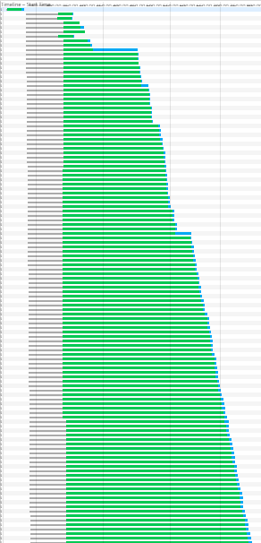

Slide 36
HTTP/2.0 HEADLINE FEATURE
Multiplexing
Priority
Flow control
Header compression
Server push

Slide 37
Stream Prioritization
Before any application data can be sent, a new stream must be created and the appropriate metadata such as HTTP headers must be sent.
In addition to the common header, an optional 31-bit stream priority has been added.
LENGTH (24)
TYPE (8)
FLAGS (8)
R
STREAM IDENTIFIER (31)
R
PRIORITY (31)
FRAME PAYLOADS (0..N)

Slide 38
HTTP/2 priority
HEADERS
Stream: 3
Flags: END_HEADERS, END_STREAM
HEADERS
Stream: 5
Flags: END_HEADERS, END_STREAM
Priority: 0
HEADERS
Stream: 3
Flags: END_HEADERS
HEADERS
Stream: 5
Flags: END_HEADERS
Priority: stream is more (lower number) or less (higher number) important
DATA
Stream: 5
Flags:
data might be sent earlier
DATA
Stream: 5
Flags: END_STREAM
DATA
Stream: 3
Flags: END_STREAM

Slide 39
Priority Stream
LENGTH (24)
TYPE (8)
FLAGS (8)
R
STREAM IDENTIFIER (31)
E
STREAM DEPENDENCY (31)
WEIGHT (8)

Slide 40
Stream Prioritization
*
*
*
*
D
8
С
8
D
8
A
12
A
12
B
4
A
12
B
4
A
12
B
4
B
4

Slide 41
HTTP/2.0 HEADLINE FEATURE
Multiplexing
Priority
Flow control
Header compression
Server push

Slide 42
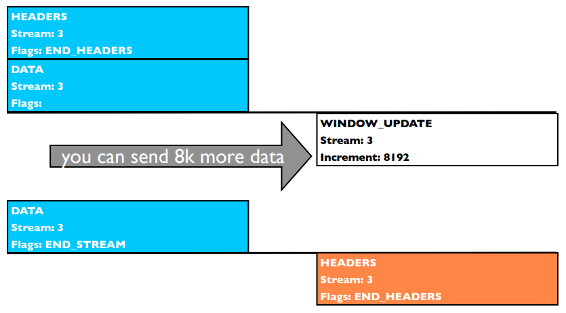
HTTP/2 flow control

Slide 43
HTTP/2.0 HEADLINE FEATURE
Multiplexing
Priority
Flow control
Header compression
Server push

Slide 44
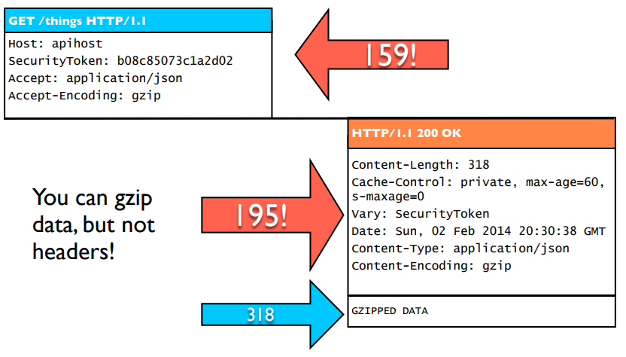
HTTP 1.1 headers

Slide 45
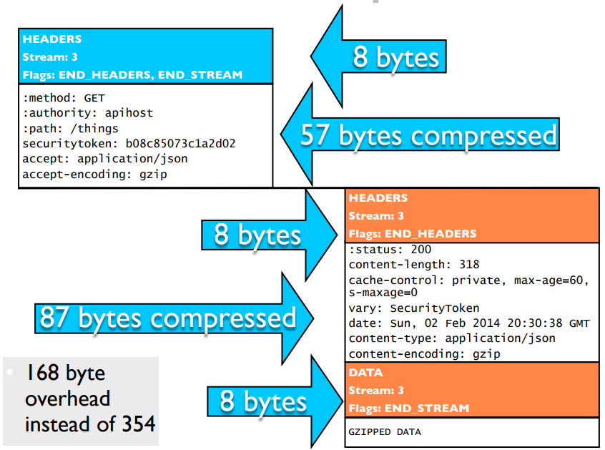
HTTP/2 header compression

Slide 46
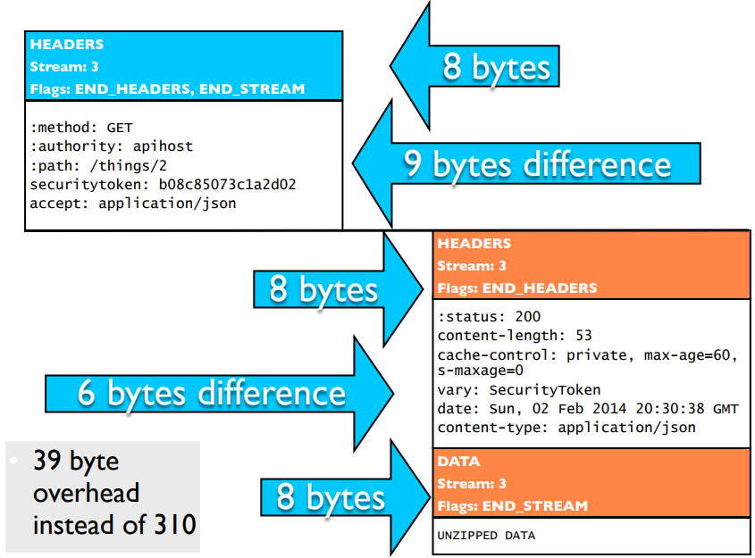
HTTP/2 reference tracking

Slide 47
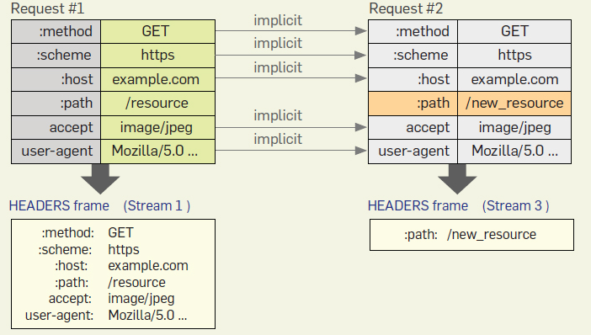
Header compression

Slide 48
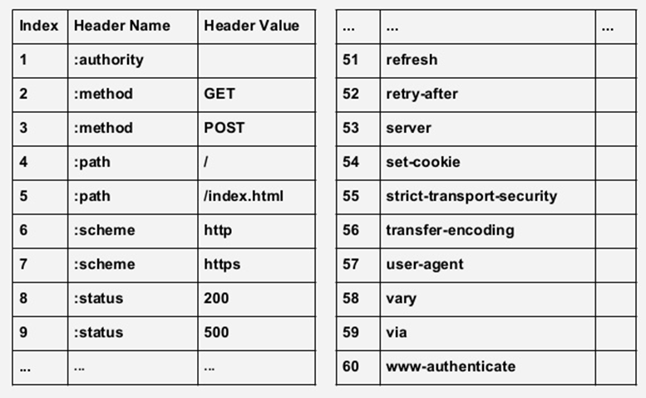
Static Header Table

Slide 49
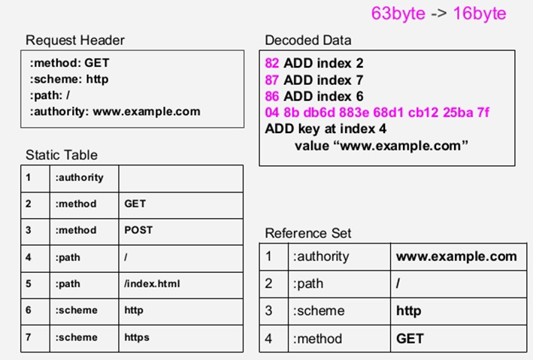
Header compression

Slide 50
HTTP/2.0 HEADLINE FEATURE
Multiplexing
Priority
Flow control
Header compression
Server push

Slide 51
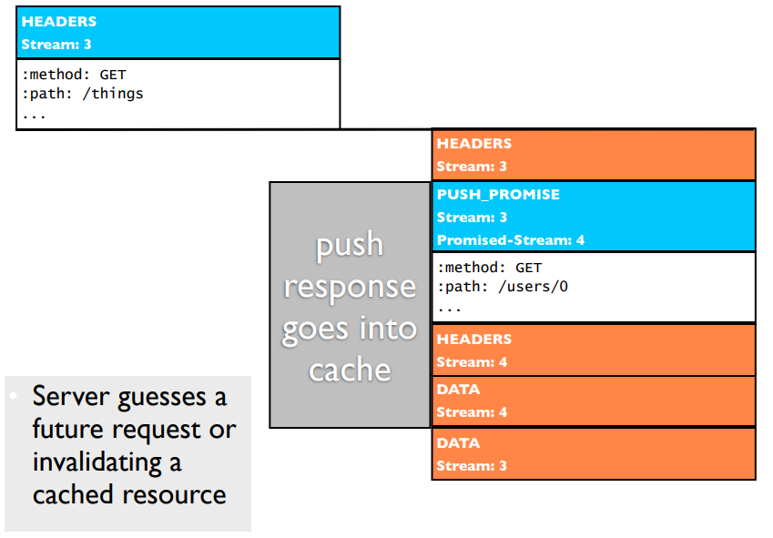
HTTP/2 push promise

Slide 52
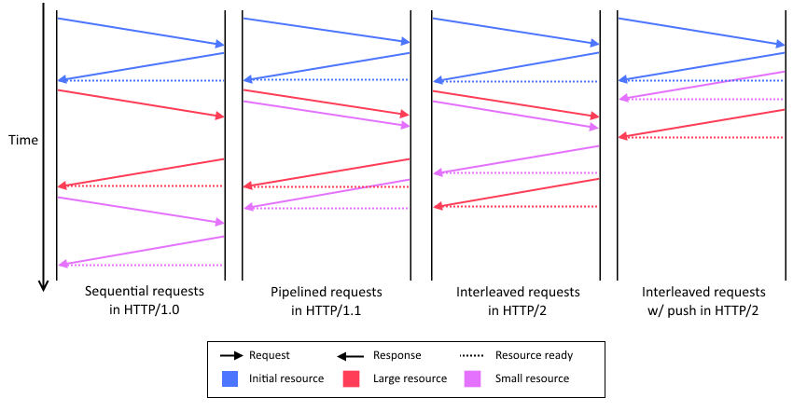
Comparison of time to fetch HTTP resources

Slide 53
Typical Journey
browser
servlet
GET /index.html
PushBuilder
request.newPushBuilder( )
setPath(“/style.css”)
push( )
setPath(“/jquery.js”)
push( )
style.css
jquery.js
index.html

Slide 54
When you don’t know if it supports HTTP/2
● “h2c” means no TLS connection
● “h2” means TLS connection [TLS-ALPN]
GET / HTTP/1.1
Host: server.example.com
Connection: Upgrade, HTTP2-Settings
Upgrade: h2c
HTTP2-Settings: <base64url encoding of HTTP/2 SETTINGS payload>
● A server MUST NOT upgrade the connection to HTTP/2 if this header field is not present or if more than one is present.
● A server MUST NOT send this header field.
[ Response ]
HTTP/1.1 101 Switching Protocols
Connection: Upgrade
Upgrade: h2c
Implicit acknowledgement of HTTP2-Settings

Slide 55
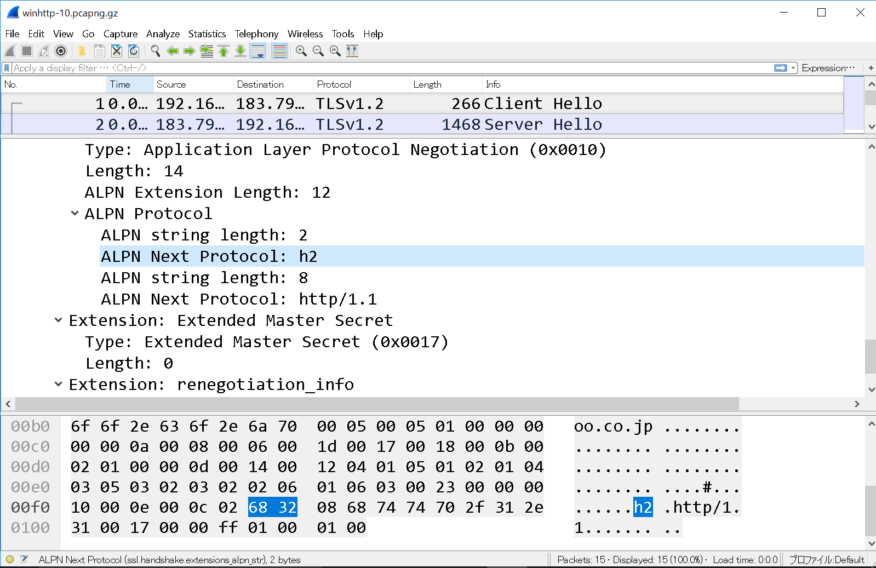

Slide 56
Configure Tomcat 9 for HTTP/2
Open the conf/server.xml file and make the following configuration changes.
<Connector port="8443" protocol="org.apache.coyote.http11.Http11NioProtocol"
maxThreads="150" SSLEnabled="true" scheme="https" secure="true"
sslImplementationName="org.apache.tomcat.util.net.jsse.JSSEImplementation"
keystoreFile=“/conf/tomcat-sslkey" keystorePass=“*******"
clientAuth="false" sslProtocol="TLS">
<UpgradeProtocol className="org.apache.coyote.http2.Http2Protocol“
initialWindowSize=“65535”
keepAliveTimeout=“-1”
maxConcurrentStreams=“200”
/>
</Connector>

Slide 57
Servlet 4.0 dependency
<dependency>
<groupId>javax.servlet</groupId>
<artifactId>javax.servlet-api</artifactId>
<version>4.0.0</version>
<scope>provided</scope>
</dependency>

Slide 58
Servlet 4.0 brings HTTP/2 to Java EE
The Servlet API is well positioned to enable HTTP/2 optimization and to allow frameworks to leverage server push.
Expose key features to the API:
Server Push
Request/Response multiplexing
Upgrade from HTTP 1.1

Slide 59
Servlet 4.0 New Features
Add method to ServletContext:
setRequestCharacterEncoding ( )
setResponseCharacterEncoding ( )
setSessionTimeout (minutes: Int)
addJspFile (name: String, jspFile:String)
Add new XML elements in web.xml:
<request-character-encoding />
<response-character-encoding />
<default-context-path />
Add new classes GenericFilter, HttpFilter

Slide 60
Push Builder from HTTP Request
fun getHttpSample(req: HttpServletRequest, resp: HttpServletResponse): String { req.newPushBuilder()?.path("/res/css/style.css")?.push() req.newPushBuilder()?.path("/res/images/logo.png")?.push() req.newPushBuilder()?.path("/res/images/background.jpg")?.push()
PushBuilder
addHeader(String, String): PushBuilder
etag(String): PushBuilder
lastModified(String): PushBuilder
queryString(String): PushBuilder
sessionId(String): PushBuilder
path(String): PushBuilder
push( )
…( )
I
HttpServletRequest
getPushBuilder( ): PushBuilder
…( )
I

Slide 61
Push Builder from HTTP Request
fun push1(req: HttpServletRequest, resp: HttpServletResponse) { val pushBuilder = req.newPushBuilder() pushBuilder?.apply { for (i in 1..250) { pushBuilder .path("res/images/space/space_$i.jpg") .addHeader("content-type", "image/jpg") .push() } }

Slide 62
Filter and Server Push feature
@WebFilter(urlPatterns = ["/*"])
class PushFilter : Filter {
override fun doFilter(req: ServletRequest, resp: ServletResponse, chain: FilterChain) {
val httpRequest: HttpServletRequest = req as HttpServletRequest
val requestURI = httpRequest.requestURI
val pushBuilder = httpRequest?.newPushBuilder()
when (requestURI) {
"index.html" -> {
pushBuilder?.path("/style.css")?.push()
pushBuilder?.path("/logo.png")?.push()
}
else -> pushBuilder?.path("/nature.png")?.push()
}
chain.doFilter(req, resp)
}
}

Slide 63
 | 41 req 172 kb | 66 req 215 kb | 130 req 427 kb | 230 req 2.0 mb | 330 req 4.2 mb | 430 req 5.4 mb
HTTP/2 | 332.37 | 415.33 | 774.13 | 1.26 | 1.83 | 2.31
HTTP 1.1 | 545.67 | 629.30 | 877.77 | 1.40 | 1.94 | 2.46
Diff % | 64.18 | 51.52 | 13.39 | 11.61 | 5.73 | 6.52

Slide 64
What about HTTP/2 client?
Client for HTTP/2 has been introduced in Java 9:
jdk.incubator.httpclient

Slide 65
Creating HTTP/2 client
val client: HttpClient = HttpClient.newHttpClient()
val client: HttpClient = HttpClient.newBuilder() .version(HttpClient.Version.HTTP_2) .build()

Slide 66
HTTP/2 client – GET request
val request: HttpRequest = HttpRequest.newBuilder() .uri(URI("http:/google.com.ua")) .GET()
.header(“page”, “1”)
.header (“limit”, “20”) .build()

Slide 67
HTTP/2 client – GET request
val response: HttpResponse<String> =
client.send (request, HttpResponse.BodyHandler.asString ( ))
val response: CompletableFuture<HttpResponse<String>> = client.sendAsync (request, HttpResponse.BodyHandler.asString())

Slide 68
Conclusion: what we get with HTTP/2
• 1 socket for 100+ concurrent streams.
• Advanced features like:
flow control
cancellation
cache push.
• Dramatically less header overhead.

Slide 69
THANK YOU!

